Slide 1


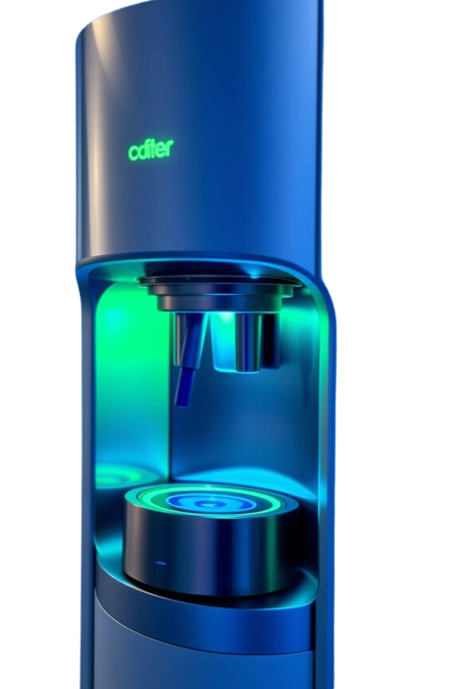

Arduino
Based Water
Dispenser System
Integration Real-Time Display, Energy Management, & Environmental Sensing

Slide 2

Project Goals
Enhanced User Experience
Our goal is to create a more intuitive and engaging user interface for water dispensing, improving the overall user experience.
Optimized Energy Efficiency
We aim to optimize the system's energy consumption through real-time monitoring and smart control, minimizing waste and reducing operating costs.
Advanced Monitoring Capabilities

Slide 3
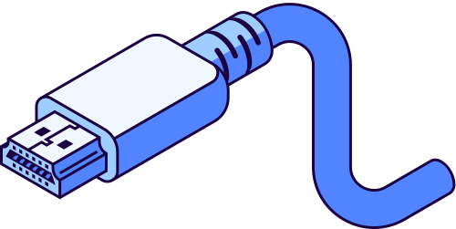
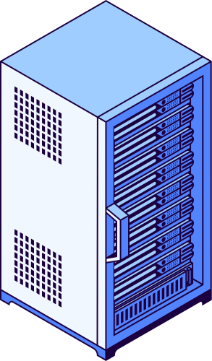
Goal
Improve the water dispenser system
Objectives
Enhance user experience, increase energy efficiency, and implement advanced monitoring capabilities.
Key Features
Real-time display, user-friendly interface, energy management, environmental sensing.

Slide 4

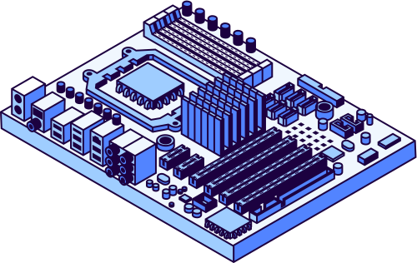
Hardware Components
Arduino Microcontroller
Environmental Sensors
Monitor temperature, humidity, and water quality for optimal performance and user safety.
LCD Display
Provides real-time information to users, including water level, temperature, and system status.
Water Pump
Dispensing water according to user instructions, ensuring precise and efficient operation.

Slide 5
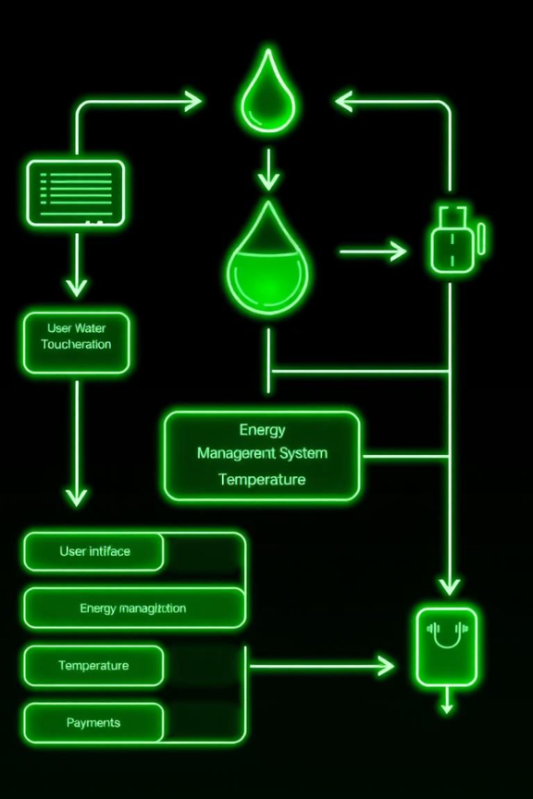
Energy Efficiency & Monitoring
10% Energy Saving
Reduced energy consumption through smart pump operation and optimized system settings.
24/7 Real-Time Monitoring
Continuous monitoring of system performance, water usage, and environmental conditions.
Data Analysis
Provides valuable data for optimizing system operations, reducing waste, and making informed decisions.

Slide 6
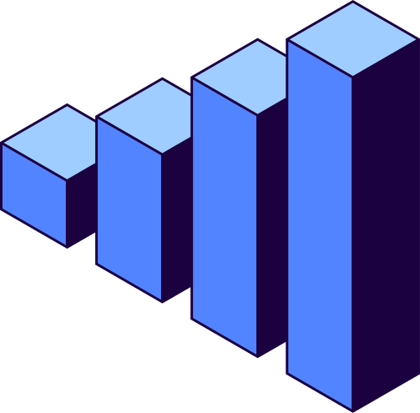
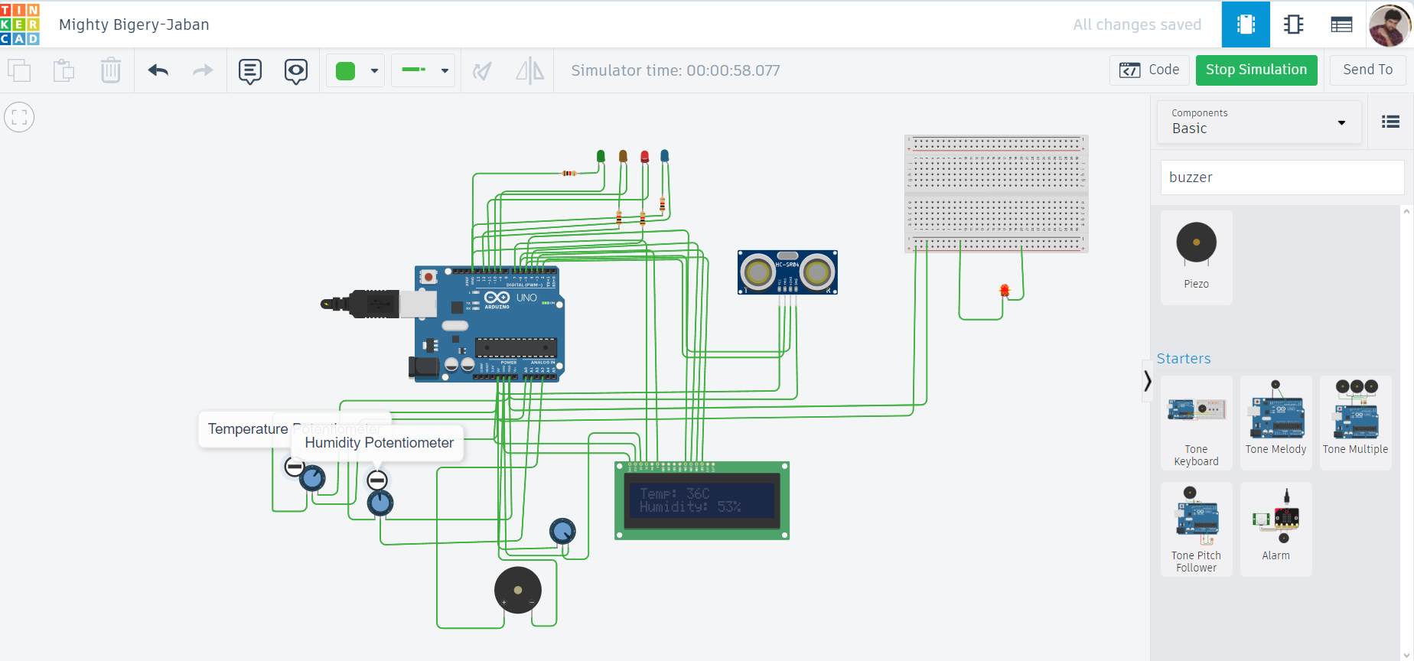
Simulation of our Project

Slide 7
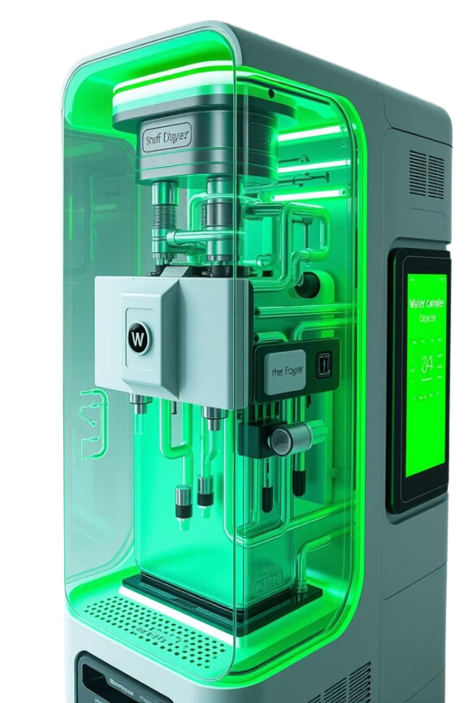
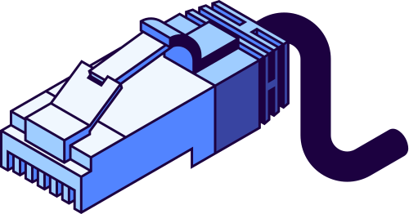
Reason for Using Potentiometers
Since the DHT sensor is unavailable in Tinkercad, two potentiometers were used to simulate temperature and humidity data.
Enhancement for LCD Display
An additional potentiometer was incorporated to control the contrast of the LCD screen.
This allows for better visibility and ensures that the displayed information is clear and easy to read during the simulation.

Slide 8
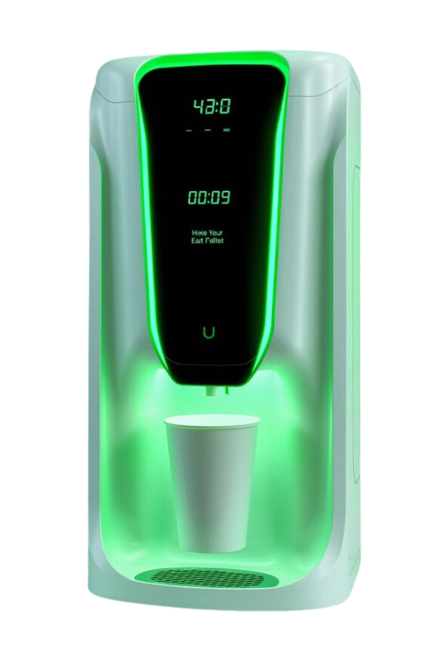
Real-time Monitoring
Water Level
Continuous water level monitoring is essential for efficient operation. The system alerts users when water is low or nearing a critical point, allowing them to refill as needed.
Error Detection
The system monitors for potential malfunctions, such as sensor failures or unexpected water level fluctuations. Error alerts are sent to the user, enabling proactive maintenance and preventing disruptions.
Temperature Monitoring
The dispenser tracks water temperature and alerts users when temperatures are too high or low. This ensures the water remains safe and drinkable for optimal hygiene.

Slide 9

User-Friendly Error Alerts
Visual Indicators
Clear visual indicators, like flashing LEDs or an alert on the LCD, inform users about errors. Users can easily identify the issue and take appropriate action.
Audio Alerts
An audible alarm, like a buzzer, can be activated in conjunction with visual indicators. This ensures that the user is alerted even if they are not directly looking at the dispenser.
Detailed Messages
The LCD display can provide detailed messages explaining the error. This allows users to understand the root cause and troubleshoot the problem efficiently.

Slide 10
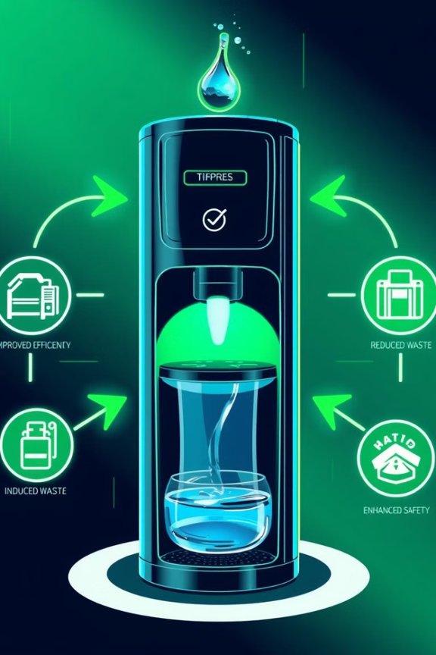
Expected Outcomes
Improved Efficiency
This smart system enhances water dispenser efficiency by optimizing water usage and minimizing waste.
Real-time Alerts
Real-time alerts for maintenance and refill needs minimize disruptions and ensure consistent access to clean water.
Enhanced Safety
Temperature monitoring and error alerts improve safety by preventing contamination and promoting reliable operation.

Slide 11

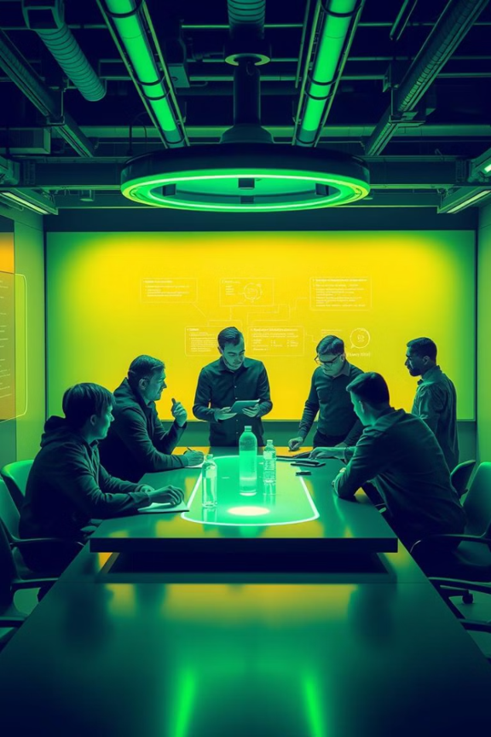
Group Members
Y.Anoshan - SEU/IS/19/ICT/007
Y.M.V.S.Weerakoon - SEU/IS/19/ICT/089
M.D.P.L.Kavinda - SEU/IS/19/ICT/095
G.M.P.Sankalpa - SEU/IS/19/ICT/036
M.N.Sibhathullah - SEU/IS/19/ICT/096

Slide 12

Studio Shodwe
Thank You!

